Slide 1

When the only constant is change:
Disruption and resilience in air transport
Andrew Matters
Deputy Chief Economist

Slide 2
Today’s flightplan:
Looking back
Evolution of the industry over the past 20 years
Key drivers of change
Looking ahead
The industry outlook; our long-term passenger forecasts
Forces shaping the future of the industry
  A final thought
  Industry challenges require industry solutions…

Slide 3
Looking back – key market developments

Slide 4
Real costs have halved, the # of city-pairs doubled
Source: IATA
Economics

Slide 5
The ‘democratization’ of air travel is clear
Source: IATA

Slide 6
Robust industry growth despite disruptions
Source: IATA
Economics

Slide 7
Regional shares have continued to evolve
Source: IATA
Economics

Slide 8
Industry profitability has improved (but not evenly)
Source: IATA
Economics

Slide 9
Key drivers of change

Slide 10
Structural & dynamic changes have been central
Market liberalisation
Air transport
International trade
Labour and product markets
(More) Harmonised regulation and Increased competition
Business operations and market structures
Innovation in business models & strategies
Greater cost efficiency and focus thereon
Developments in consolidation and alliances
Safety and Security
Technology
Aircraft
Direct distribution
Airports
Customer experience

Slide 11
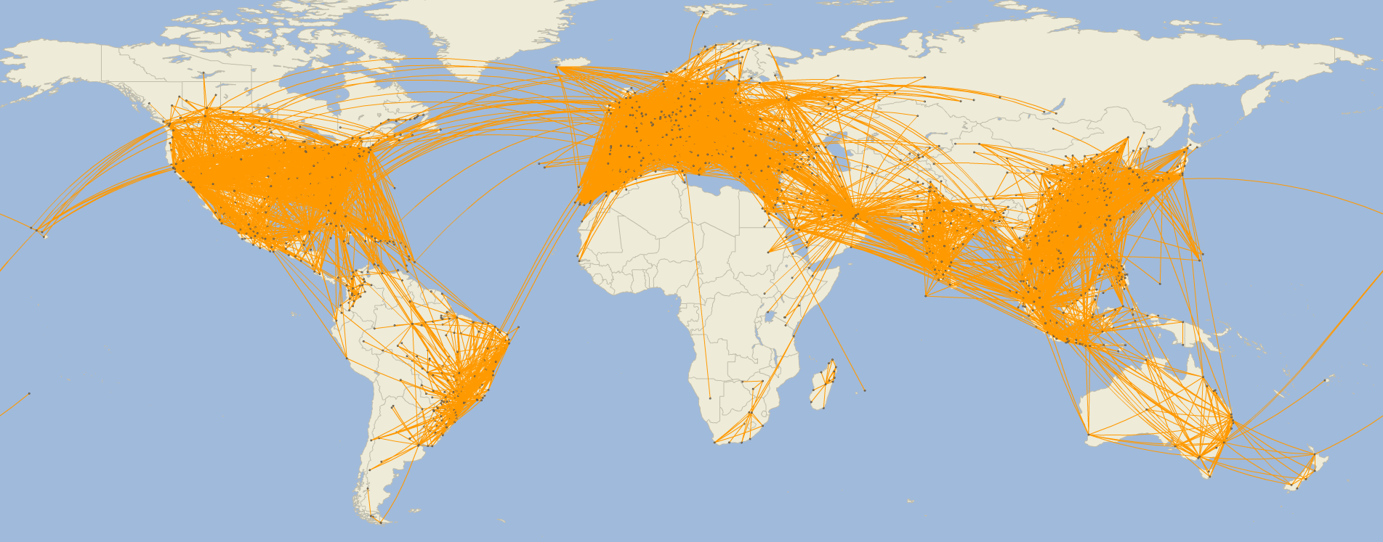
Business model evolution has disrupted the industry
LCC route network 2019
Source: SRS Analyser
Economics

Slide 12
The nature of the industry has changed…
Source: ICAO, IATA

Slide 13
…and the nature of the product has changed too
Source: IATA

Slide 14
Technology has helped cut costs & boost efficiency
Source: Lee

Slide 15
Large efficiency gains, but airline CO₂ still rising…
Source: UN, IATA/Tourism Economics

Slide 16
Looking ahead…

Slide 17
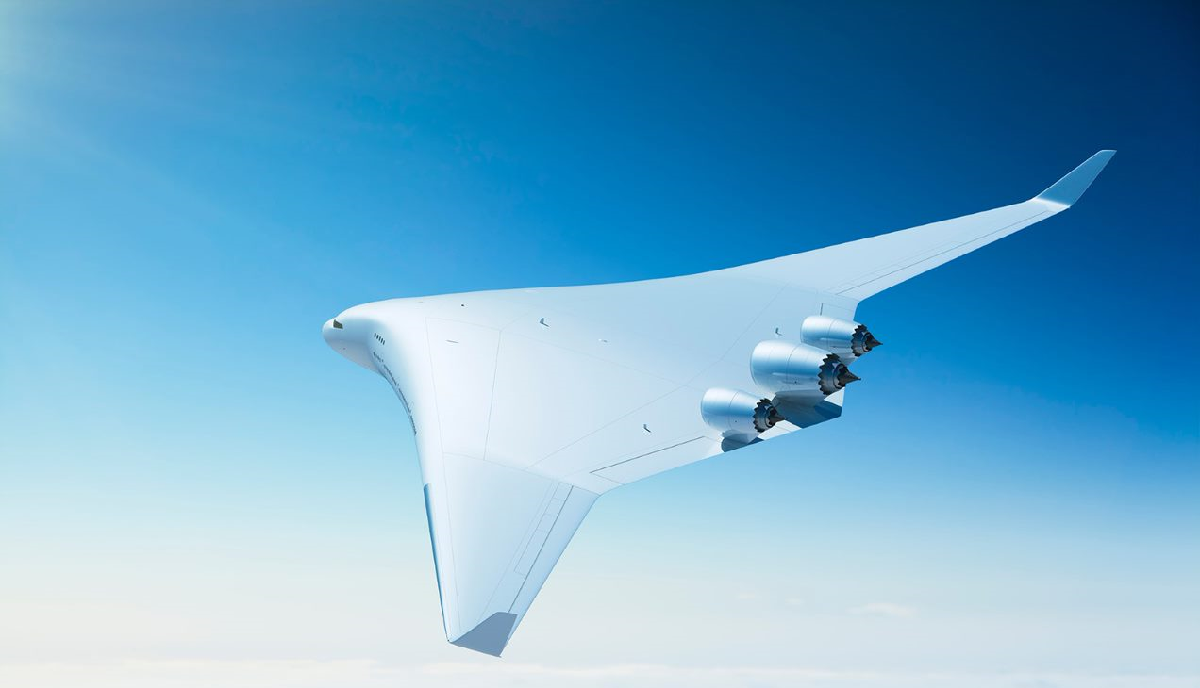
“Prediction is very difficult, especially if it's about the future…”
- Niels Bohr, Nobel Physicist
Economics

Slide 18
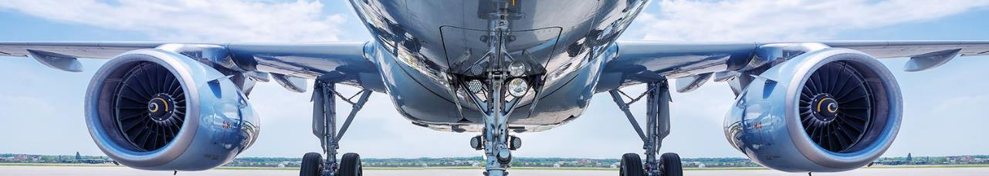
The longer-term industry demand outlook is bright…
8.1bn
The total number of air passenger journeys in 2038
3.9%
Average annual growth over the
next 20yrs
2.1x
The number of air passenger journeys
in 2038 vs today
Source: IATA/Tourism Economics

Slide 19
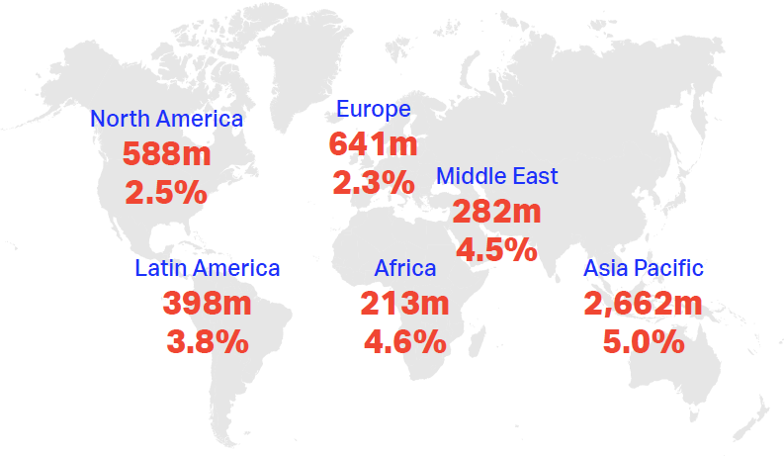
Where’s the growth coming from?
Source: IATA/Tourism Economics

Slide 20
Forces shaping the future of the industry

Slide 21
The customer is central to the industry’s future
Globalisation
Environment
Technology
Infrastructure
Source: IATA
Economics

Slide 22
Globalisation has changed
Source: Netherlands CPB
Economics

Slide 23
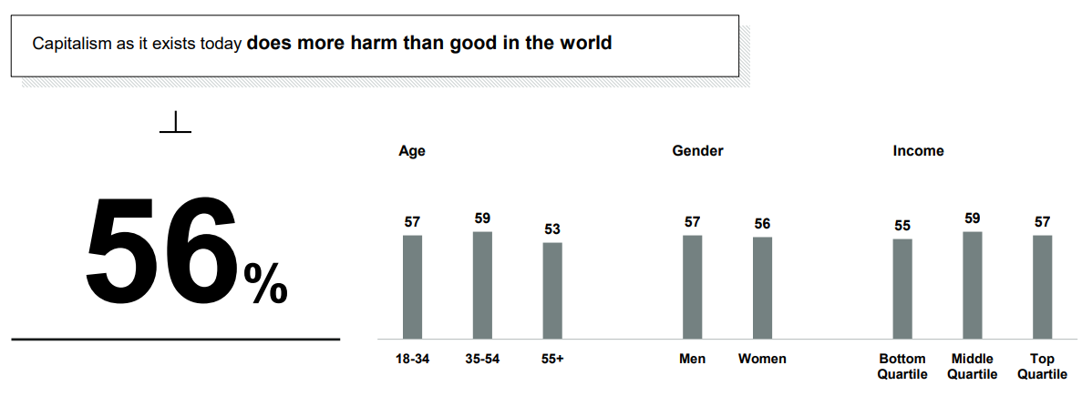
The current global system is being questioned…
AGREE
Source: Edelman
Economics

Slide 24
…and the future of globalisation is unclear
Source: IATA
Economics

Slide 25
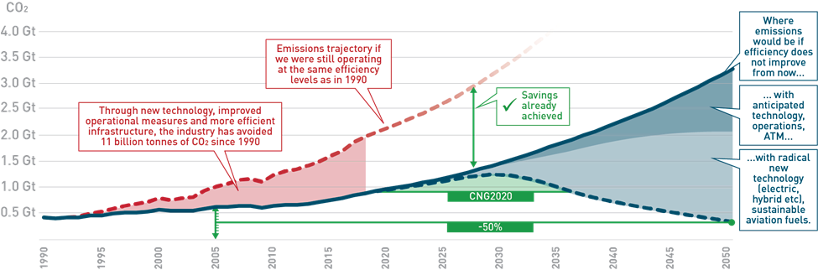
Environmental sustainability is an industry priority
More at: www.iata.org/en/programs/environment/ and aviationbenefits.org/environmental-efficiency/climate-action/
Source: IATA/ATAG
Economics

Slide 26
Climate is now a mainstream issue for investors too
Source: HSBC

Slide 27
The 4th Industrial Revolution has broad implications
Source: WEF
Notes:
This Fourth Industrial Revolution is, however, fundamentally different. It is characterized by a range of new technologies that are fusing the physical, digital and biological worlds, impacting all disciplines, economies and industries, and even challenging ideas about what it means to be human.
The resulting shifts and disruptions mean that we live in a time of great promise and great peril. The world has the potential to connect billions more people to digital networks, dramatically improve the efficiency of organizations and even manage assets in ways that can help regenerate the natural environment, potentially undoing the damage of previous industrial revolutions.
However, Schwab also has grave concerns: that organizations might be unable to adapt; governments could fail to employ and regulate new technologies to capture their benefits; shifting power will create important new security concerns; inequality may grow; and societies fragment.
The Fourth Industrial Revolution is a way of describing the blurring of boundaries between the physical, digital, and biological worlds. It's a fusion of advances in artificial intelligence (AI), robotics, the Internet of Things (IoT), 3D printing, genetic engineering, quantum computing, and other technologies.

Slide 28
Four digital themes are shaping travel & tourism
Living travel experience
Travelers will experience seamless journeys tailored to their habits and preferences.
Digital enterprise
Digital technologies that revolutionize manufacturing, optimize asset use and augment the workforce will transform operations.
Enabling the travel ecosystem
Ecosystem roles are blurring as stakeholders throughout the customer journey vie to own the customer relationship.
Safety & Security
As identity management becomes increasingly digital, cybersecurity and data protection will be crucial to maintaining customer trust and public safety.
Source: WTO

Slide 29
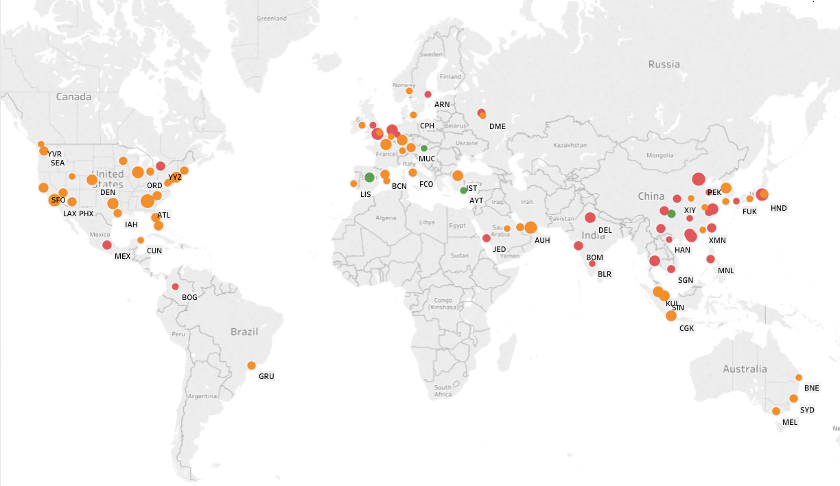
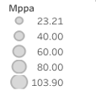
Managing congestion is a growing concern…
Presently congested
Congested by 2028
Sufficient capacity in 2028
Runway and terminal capacity limits are based on airport stated capacity limits. This may not be reflective of the most efficient use of existing infrastructure.
Airport congestion is assessed on the basis of annualised runway and terminal capacity and traffic volumes, and does not capture seasonality of traffic.
Airport congestion is assessed on a status quo basis, meaning that expansion plans are not fully accounted for.
Top 100 airports of the world
Source: IATA/Tourism Economics, airport websites & publicly available documents

Slide 30
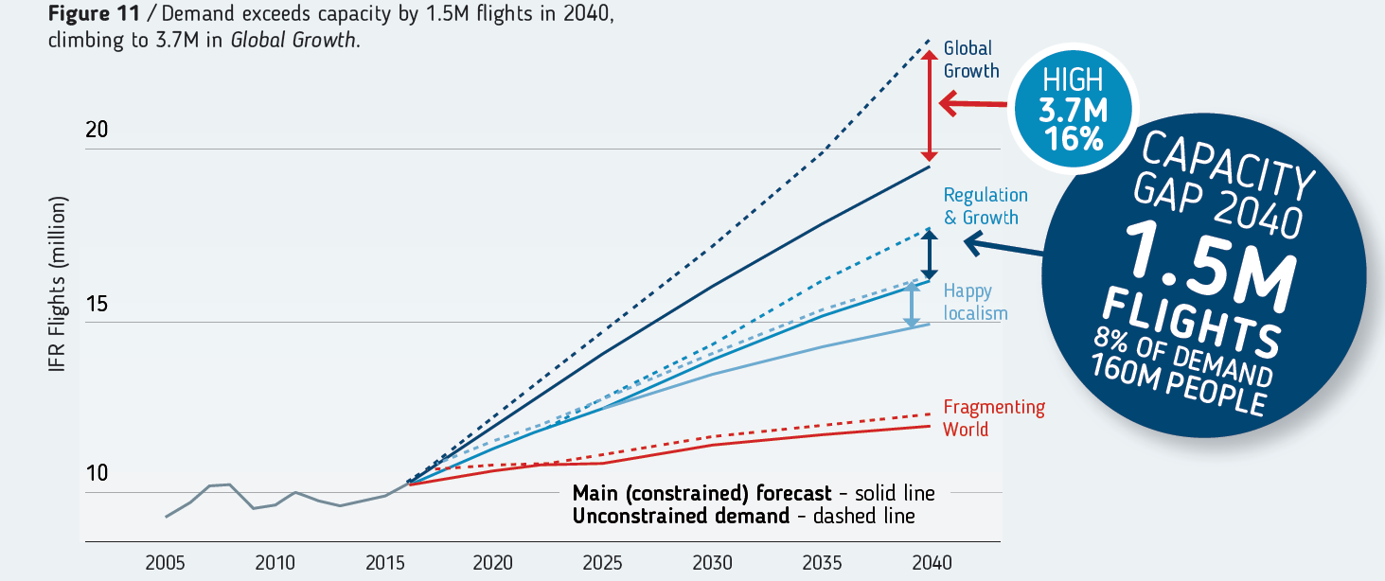
…including in Europe
Demand in Europe to exceed capacity by
1.5m flights or 160m pax by 2040
million IFR flights
Source: Eurocontrol
Economics

Slide 31
One final thought…

Slide 32
Air transport & the economy are not independent
Passenger demand
Infrastructure
Economic Stimulus
Industry cost competitiveness
Trade
Investment
Tourism
R&D
Innovation
Regulatory environment
Sustainable Air Transport
Economic Benefits
Open Borders
Business climate &
employment
Air Connectivity
Lower air travel costs
Source: IATA Economics

Slide 33

Andrew Matters
Deputy Chief Economist
IATA
mattersa@iata.org
www.iata.org/economics

Slide 34
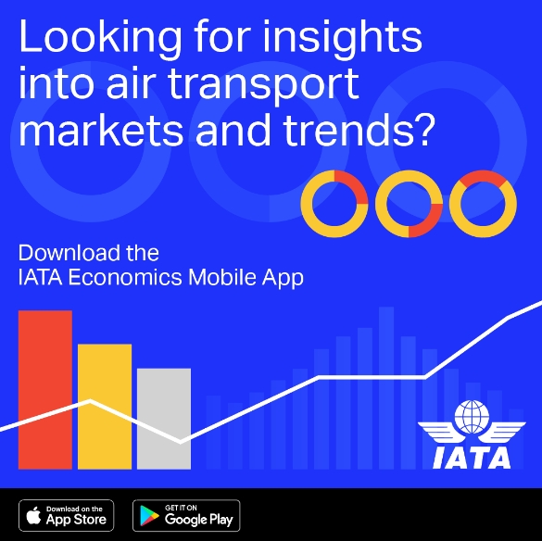
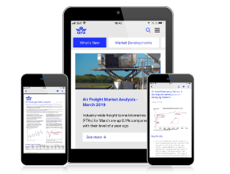
IATA Economics Mobile App
Keep up to date with IATA Economics’ latest research & analysis on key aviation issues,
insights and market trends.
Receive notifications when a new report is available, share content through social media and email.
Access industry-leading economic analysis on key aviation and market trends through:
Reports
Charts
Presentations
Videos and more…
To find out more visit: www.iata.org/econapp
Economics

